Slide 1
Energy Consumption Prediction
Tanzila Nasrin Tazin [ID-200488998]
CS 718 & 719 Data Science Project
Notes:
Are your classroom colors different than what you see in this template? That’s OK! Click on Design -> Variants (the down arrow) -> Pick the color scheme that works for you!
Feel free to change any “You will…” and “I will…” statements to ensure they align with your classroom procedures and rules!

Slide 2
Overview
Motivation
Objectives
Methodology
2
Achievements & Challenges

Slide 3


Motivation
Economic Efficiency
Environmental Sustainability
Innovation and Infrastructure Planning

Slide 4


Objectives
Utilize machine learning models (ANN, SVM) to predict accurate electricity consumption.
Understand how weather conditions influence energy usage.

Slide 5
Methodology
Artificial Neural Network
Support Vector Machine
Learning from Data
understanding complex patterns
Parallel Processing
Continuous Improvement
Memory Efficiency
Outlier Detection
Handling Non-linear Data
Notes:
Learning from Data: ANNs have the ability to learn and model non-linear and complex relationships between inputs and outputs. This makes them highly effective for modeling complex patterns in data, which might not be feasible with traditional statistical models.
understanding complex patterns: What makes ANNs special is their knack for understanding complex patterns in data. They can break down these patterns into smaller parts, making it easier to understand them. This is useful when the connections between different things in the data are complicated and can't be explained by simple models.
Parallel Processing: They are inherently suited for parallel processing, which can significantly speed up their training and inference times, especially when implemented on modern hardware architectures like GPUs.
Continuous Improvement: As more data becomes available, ANNs can be retrained or fine-tuned, allowing them to improve over time. This property is particularly valuable in dynamically changing environments or applications where new data are constantly generated.

Slide 6


Achievements
Data Preprocessing
Data Correlation
Model Implementation
Categorical to Numeric
Datetime
Heatmap
Histogram
ANN Model
Error Calculation

Slide 7


Challenges
Previous Challenge: Data Correlation
Identifying and understanding the relationships within the data.
Ensuring robust and meaningful correlations.
Current Challenge: Model Accuracy
Implementing advanced algorithms and tuning model parameters for improved performance
Continuously validating and testing model outputs.

Slide 8
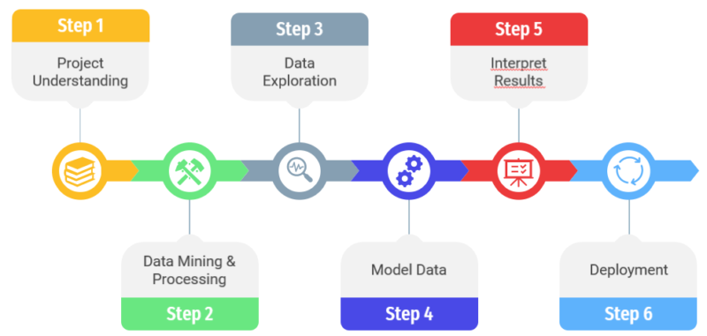
Design of Project
Project Understanding
Data preprocessing
Model Evaluation
Dataset Selection
Data Modelling
Interface

Slide 9

Remaining Work
Interface Making
Find the Best Model

Slide 10



